Slide 1
Blazor and Azure functions for Serverless Website

Slide 2




Menaka BaskerPillai
Accenture
menabasker1996@gmail.com
Azure and .Net Certified Professional
Blogger
International Speaker
C# corner MVP
@MenakaBasker
https://www.linkedin.com/in/menakapriyadharshini-basker-291600188/

Slide 3
Agenda
Types of Blazor Hostings
Standard Web App Architecture
Serverless Web App Architecture
Consuming Azure Function in Blazor App
Hosting Blazor App in Storage Account

Slide 4
Type of Blazor Hostings
Server App
Web Assembly App

Slide 5
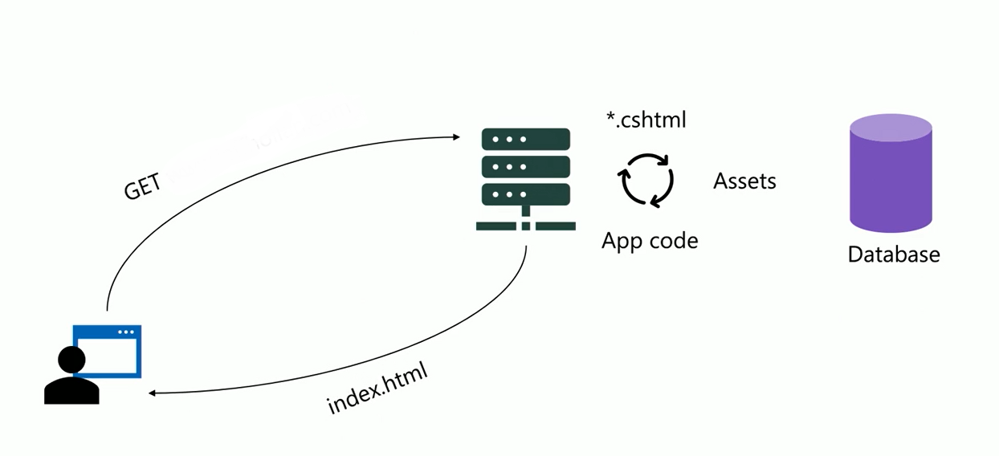
Standard Web App Architecture

Slide 6
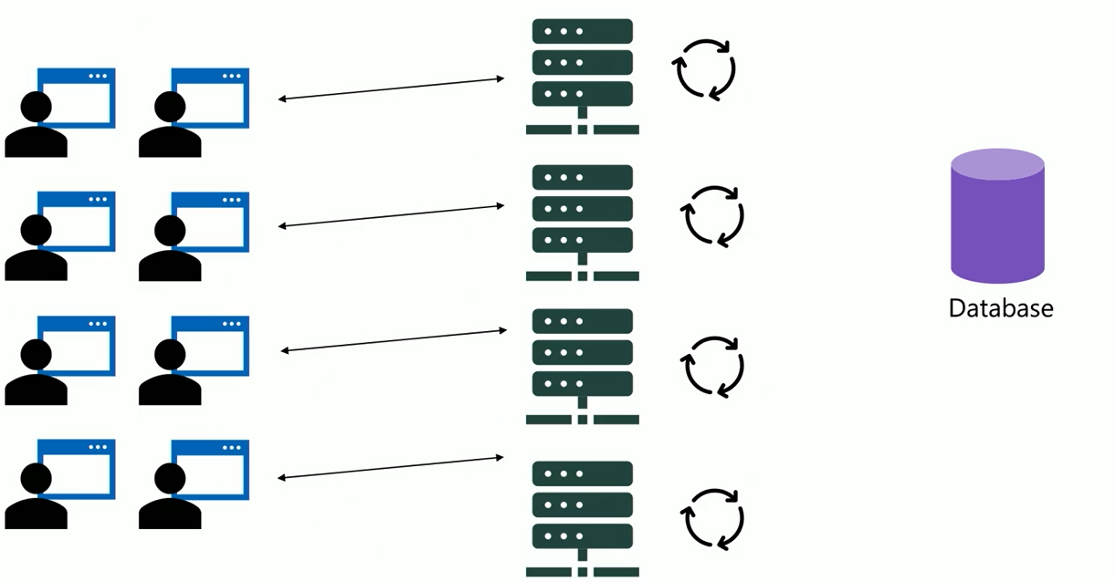
Standard Web App Architecture

Slide 7
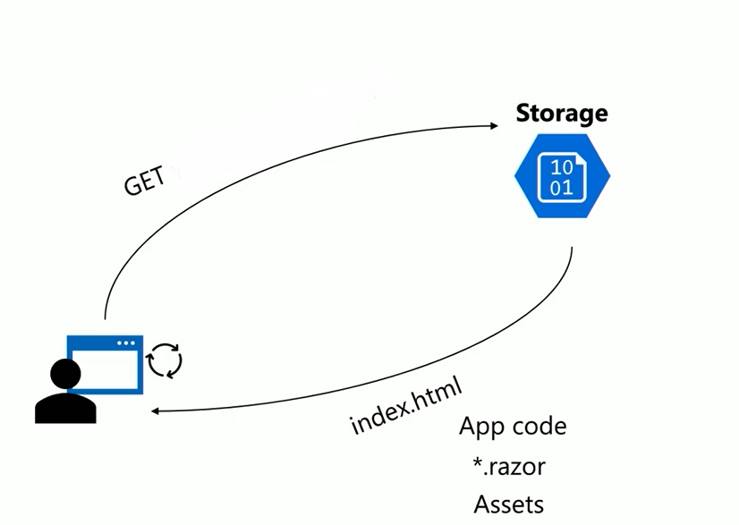
Serverless Web App Architecture

Slide 8
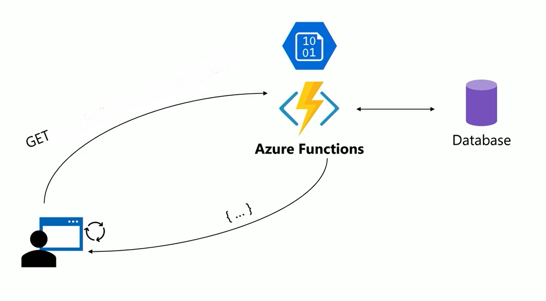
Serverless Web App Architecture

Slide 9
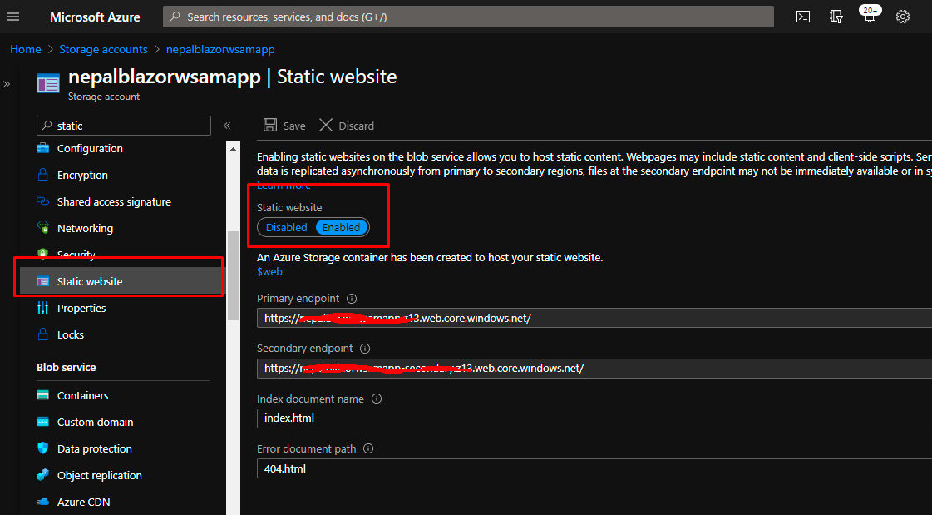
Hosting Blazor App in Storage Account

Slide 10
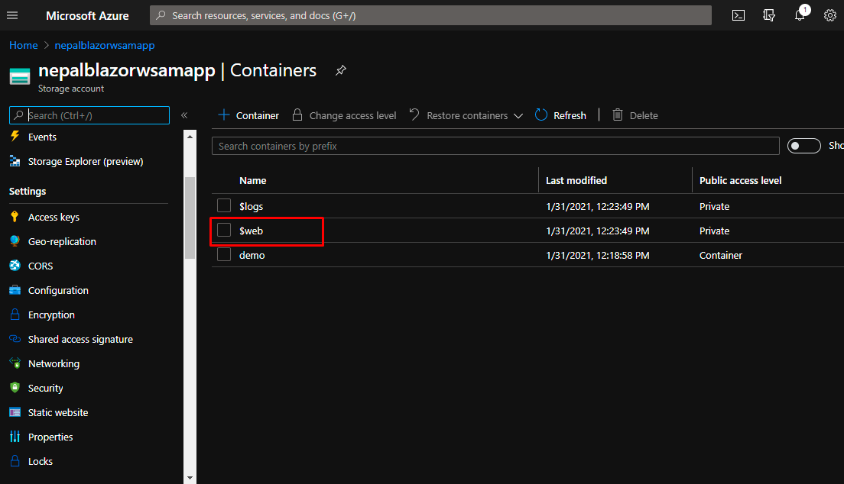
Hosting Blazor App in Storage Account

Slide 11
DEMO

Slide 12

THANK YOU
menabasker1996@gmail.com
@MenakaBasker

